Slide 1
A/B testing

Slide 2
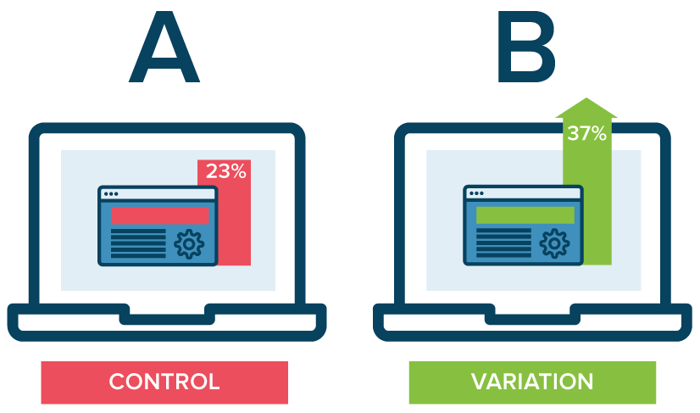
What is A/B testing?
A/B testing (sometimes called split testing) is comparing two versions of a web page to see which one performs better
Notes:
You compare two web pages by showing the two variants (let's call them A and B) to similar visitors at the same time. The one that gives a better conversion rate, wins!

Slide 3
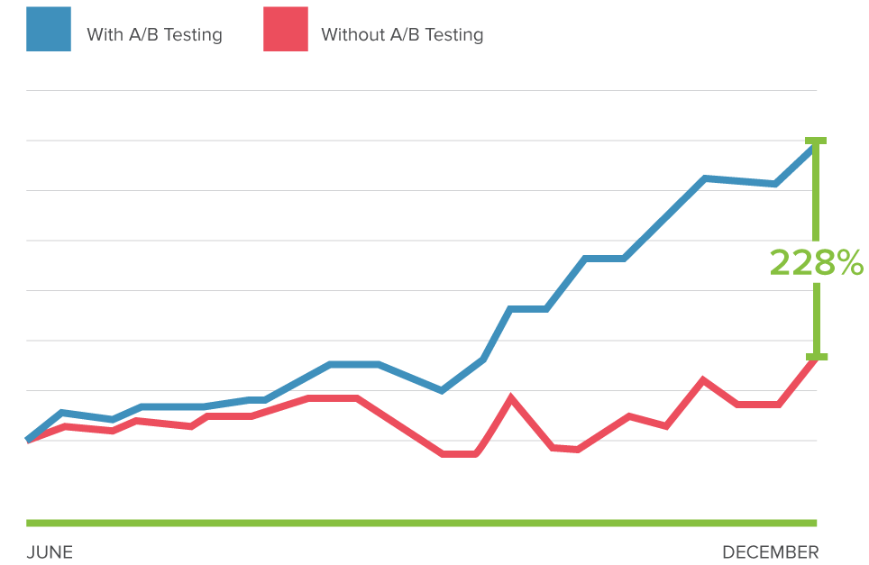
Why should use A/B testing?
A/B testing allows individuals, teams, and companies to make careful changes to their user experiences while collecting data on the results.

Slide 4
A/B testing examples
A media company
Email sign-up modals
A travel company
Homepage search modals
Search results page
An e-commerce company
Homepage promotions
Navigation elements
Recommended content
Social sharing buttons
Ancillary product presentation
A technology company
Checkout funnel components
Lead form components
Free trial signup flow
Homepage messaging and call to action

Slide 5
Conversation metrics
Traffic source
direct visitors, search visitors, referral visitors
New/Unique visitor conversion
isolate the first-time visitors to make strategies
New/Unique visitor conversion
Return visitor conversion
isolate the first-time visitors to make strategies
Interactions per visit
why return, and what they did not convert in first time
time spend, comments made
Cost per conversion
Bounce rate
The cost of experiments
Exit pages
the rate at which new visitors visit your site and immediately click away without doing anything
examines people who get off your landing page to explore your site further. You’ve piqued their interest and they want to read more

Slide 6
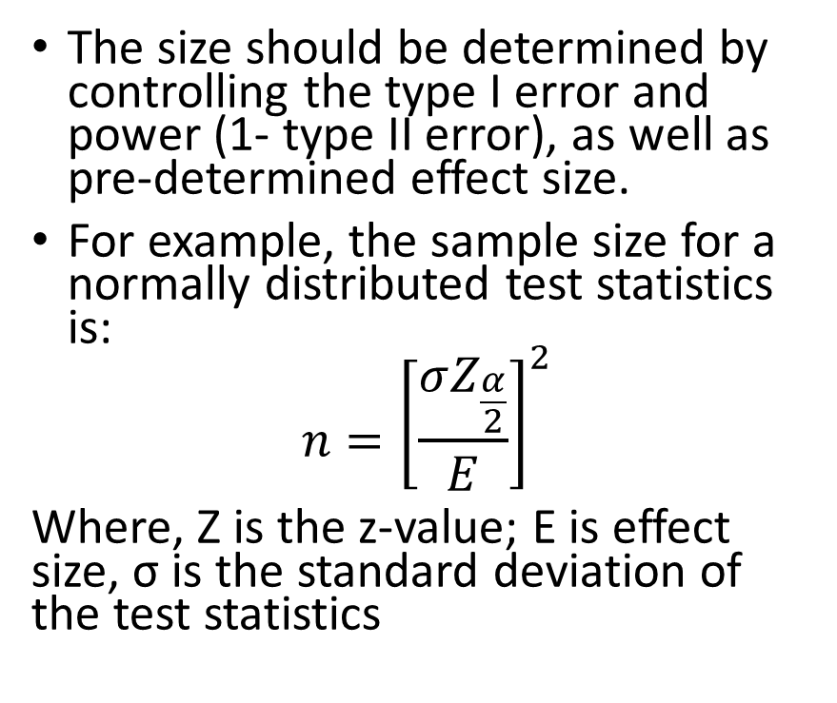
How to determine the sample size?
The size should be determined by controlling the type I error and power (1- type II error), as well as pre-determined effect size.
For example, the sample size for a normally distributed test statistics is:
$$n={\left[\frac{σZ_{\frac{α}{2}}}{E}\right]}^{2}$$
Where, Z is the z-value; E is effect size, σ is the standard deviation of the test statistics
Type I error
Null is true; reject the null
Correct inference
Null is false; reject the null
Type II error
Null is false; do not reject the null
Correct inference
Null is true; do not reject the null

Slide 7
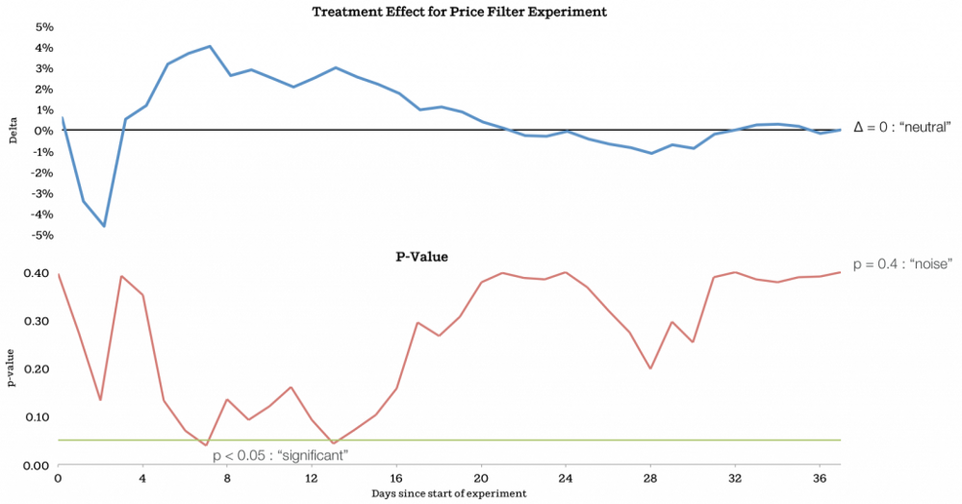
How long the experiment should be?
The treatment effect (delta of treatment) and p-values over time are plotted.
Stop when a stable status has arrived

Slide 8
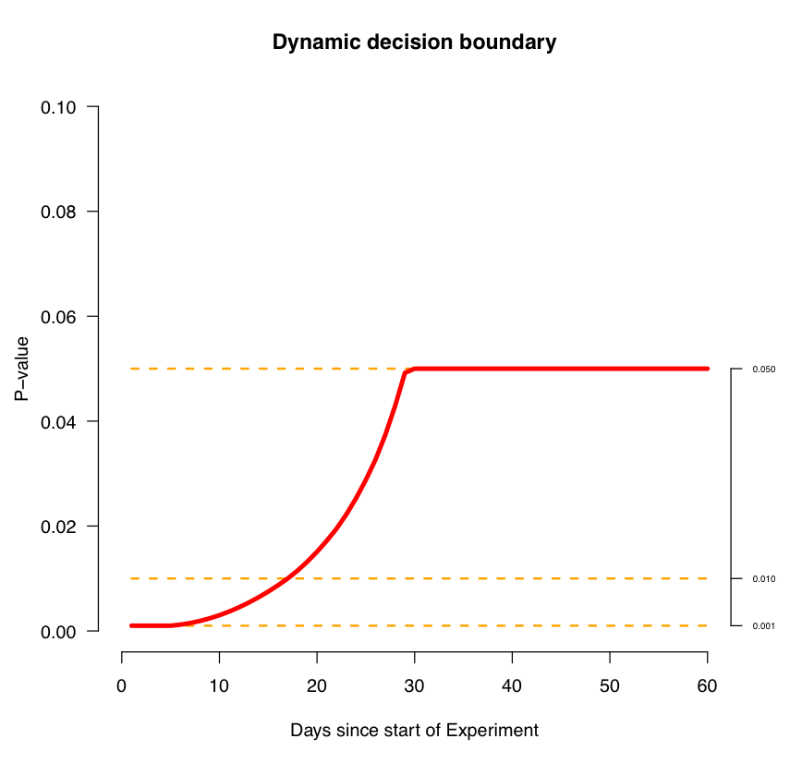
Early determination
Dynamic early determination: the threshold should be lower if want to determine earlier. Use simulation varying the parameters like real effects size , variance to control the type I and type II error, and thus determine the earlier stop threshold.

Slide 9
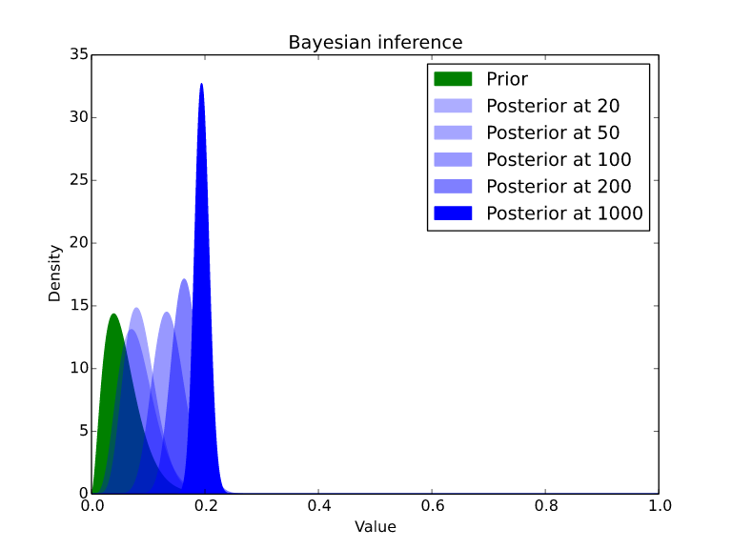
Bayesian A/B testing
The essence of Bayesian methods consists in identifying prior beliefs about what results are likely, and then updating those according to the data we collect.
For example, if the base conversion rate is 5%, we want to test whether the new way could improve conversion rate by 10 %

Slide 10
Bayesian vs. Frequentist
Frequency method is used for point estimate (trend test or comparison). The results are determined by the p-value of the test. while Bayesian method provide a probability distribution. And thus, frequentist provide the test related to measure of magnitude, but the Bayesian cold not
Using an informative prior allows us to alleviate many of the issues that plague classical significance testing( eg. Low base rate problem)
Bayesian require to specify the priors and did worse on small data set
Bayesian tend to handle biased population distributions better than Gaussian frequentist approaches.

Slide 11
Understanding results
Generally, evaluate the experiments based on single metric of interest.
Study the results in different sub-types, for example, different browsers. Confounders and Simpsons paradox might influence the results.
If the results are too good to be true: run A/A test with different splits

